Slide 1
IRISH STOCK MARKET ANALYSIS
AAYUSH JAIN – 10518910
BHARAT JETHWANI – 10519364
NEERAJ CHAVAN – 10521393
PRASAD TAMBE - 10515513

Slide 2
CONTENTS
Introduction
Dataset
Schema
ETL
Visualization & Reports
XML & Schema
Neo4j
Conclusion

Slide 3

INTRODUCTION
Stock Prediction
Stock

Slide 4
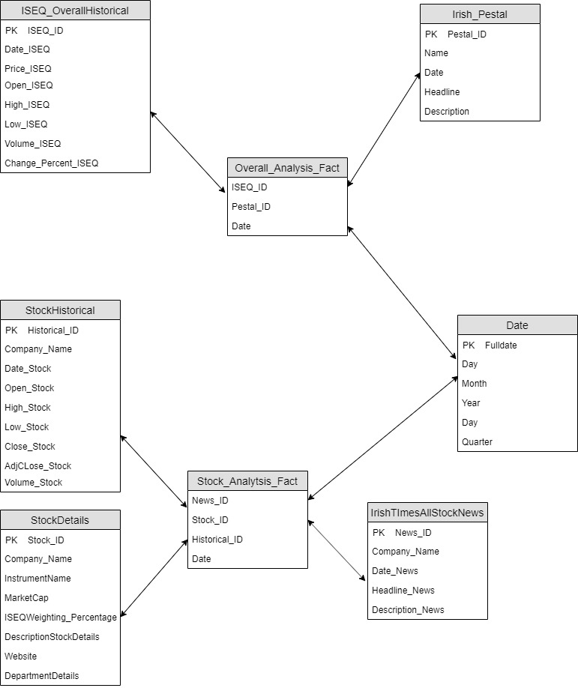
SCHEMA

Slide 5
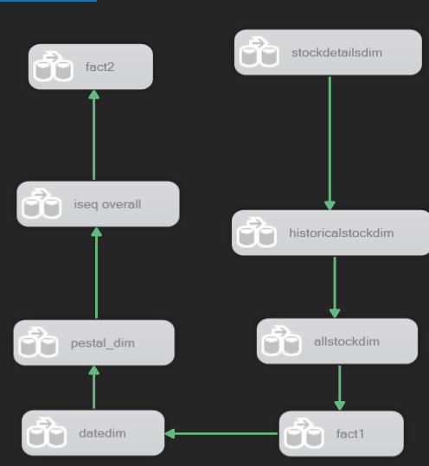
ETL
Notes:
Consider talking about:
School and university
Project management
Civil and military construction and industry infrastructure
Computer software
State project

Slide 6
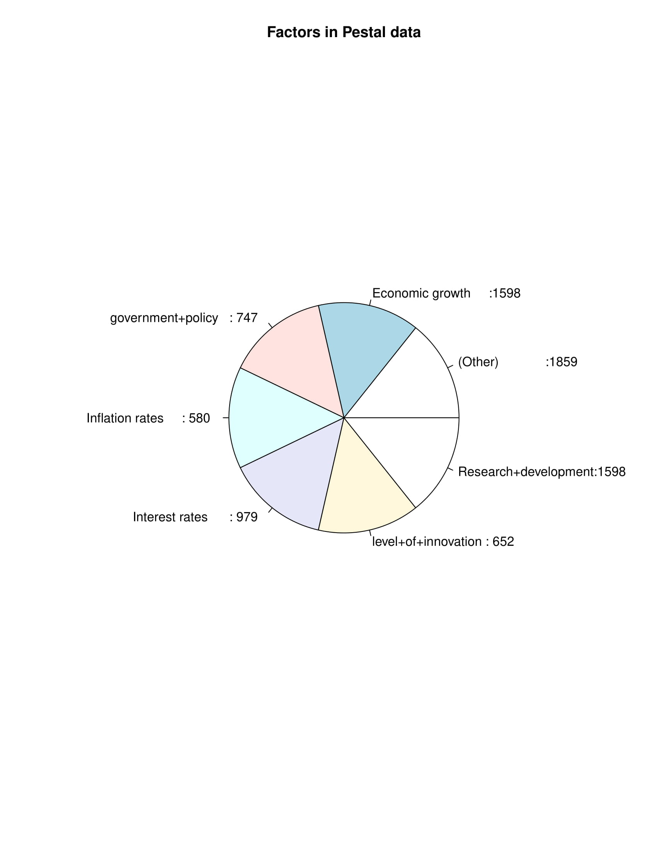
VISUALIZATION & REPORTS

Slide 7
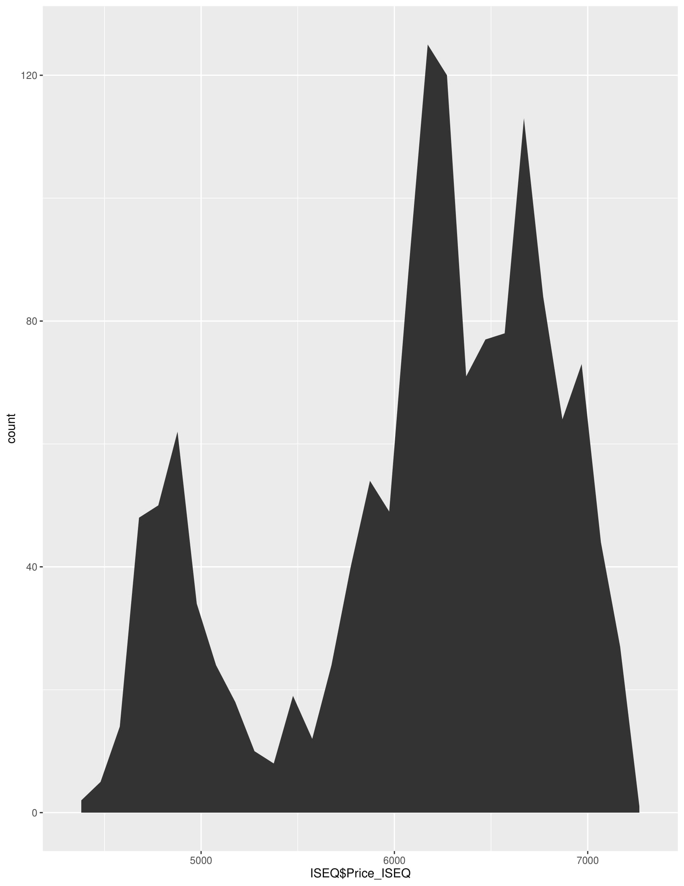
VISUALIZATION & REPORTS

Slide 8
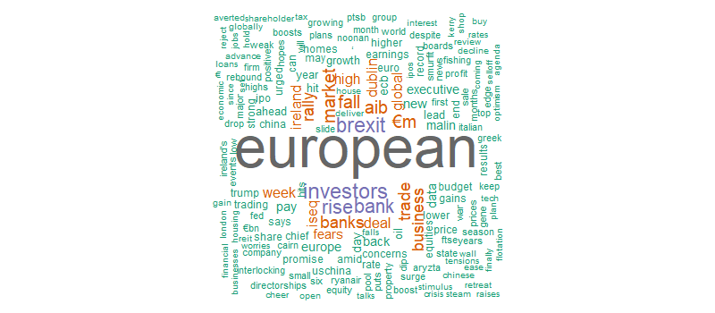
VISUALIZATION & REPORTS

Slide 9
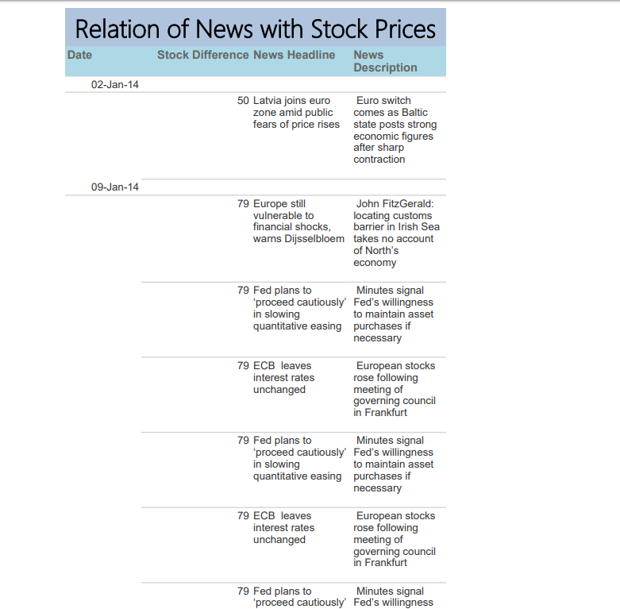
VISUALIZATION & REPORTS

Slide 10
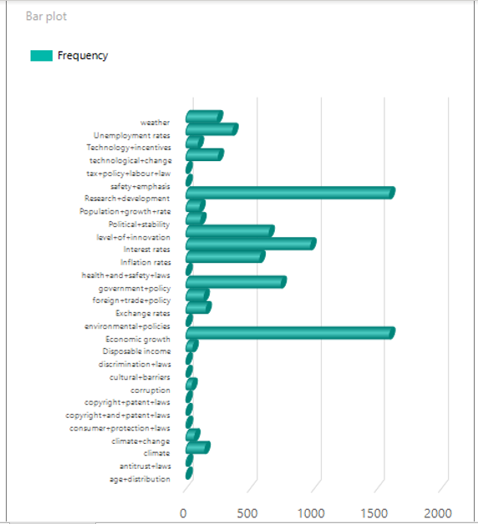
VISUALIZATION & REPORTS

Slide 11
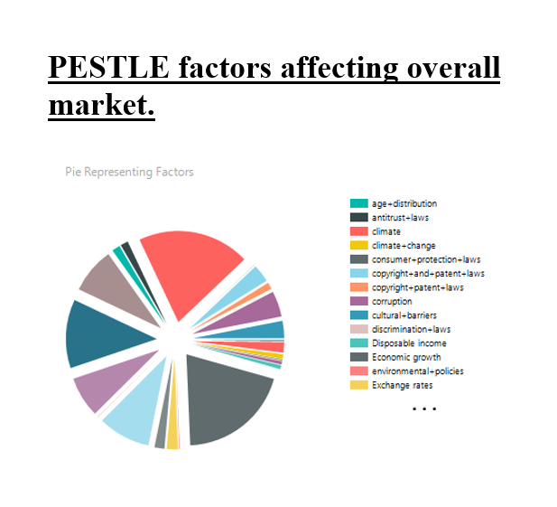
VISUALIZATION & REPORTS

Slide 12
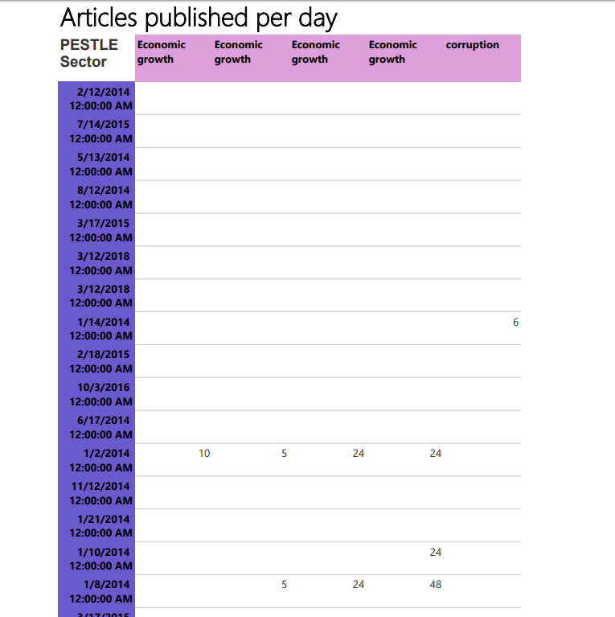
VISUALIZATION & REPORTS

Slide 13
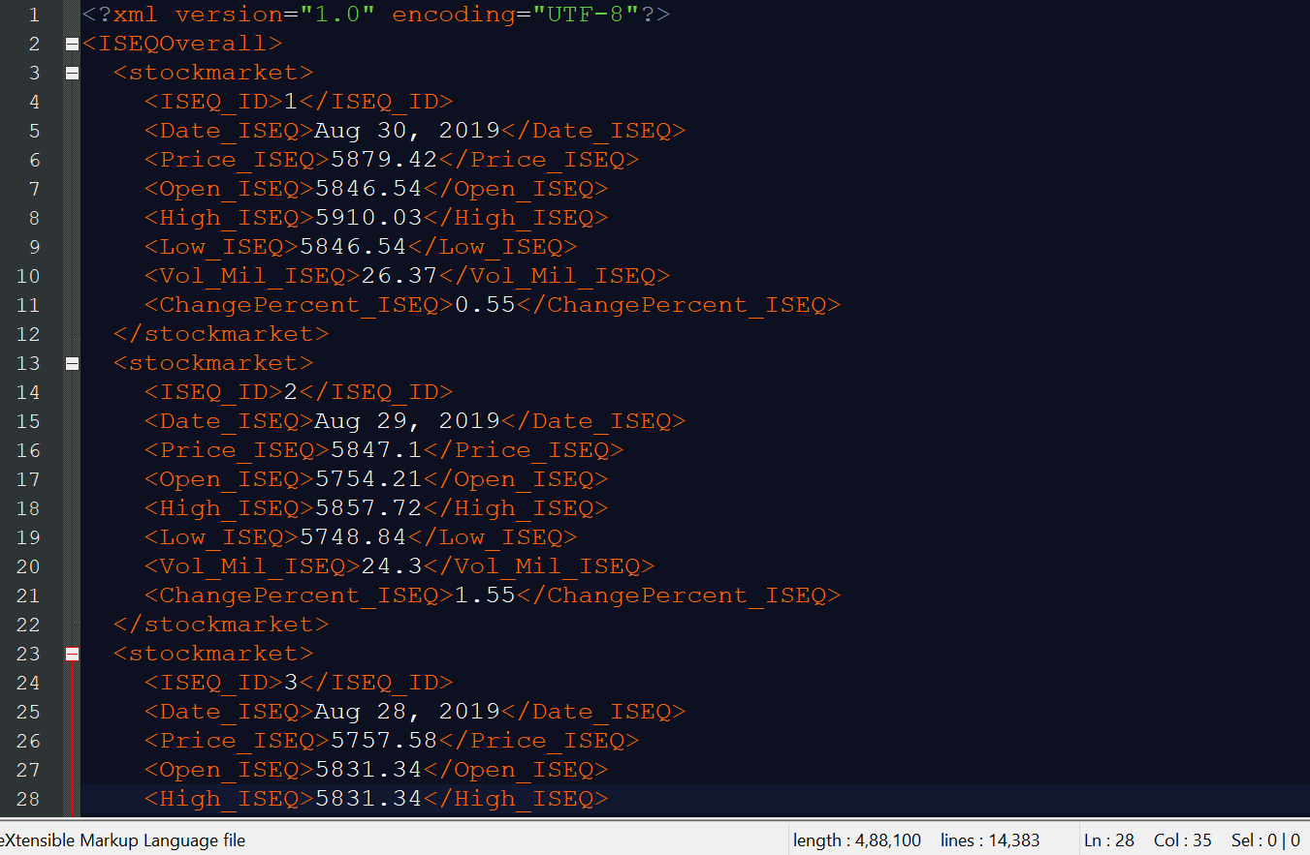
XML & SCHEMA

Slide 14
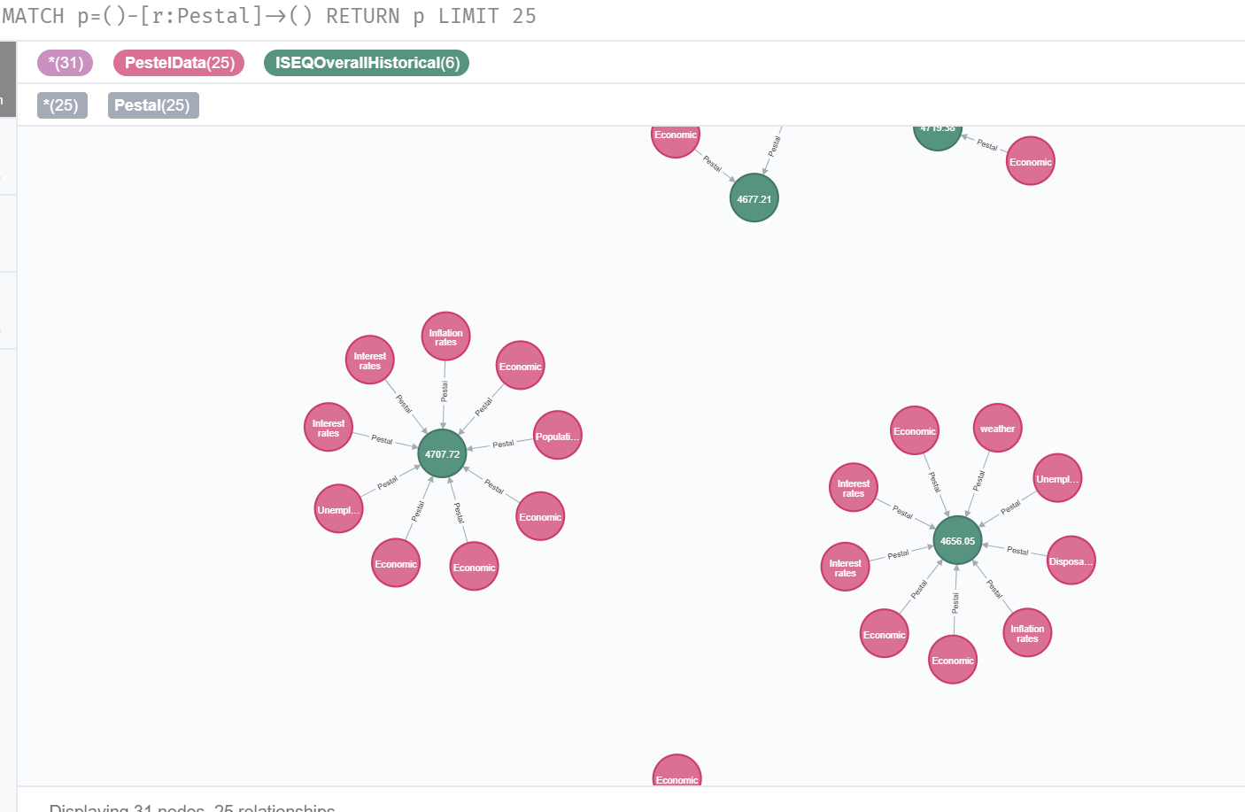
NEO4J

Slide 15
CONCLUSION
In this project, we have aimed to analyse the impact of real world events and news headlines on the stock market. Having used data scraped from multiple sources for our analysis, we understood how to effectively clean and integrate the data and then store it in the SQL database. Using SSIS we performed the ETL and learnt the various SSIS tools available in Visual Studio. Later we generated reports and visualizations in SSRS and R, to gather insights from the data, as per the business requirements.
We created the relevant XML and Schema. Also, we explored Neo4j graph databases and understood the advantages of graph databases.
Moving on, this project can be further expanded to store data in real time and generate predictions regarding stock prices accordingly.

